Slide 1
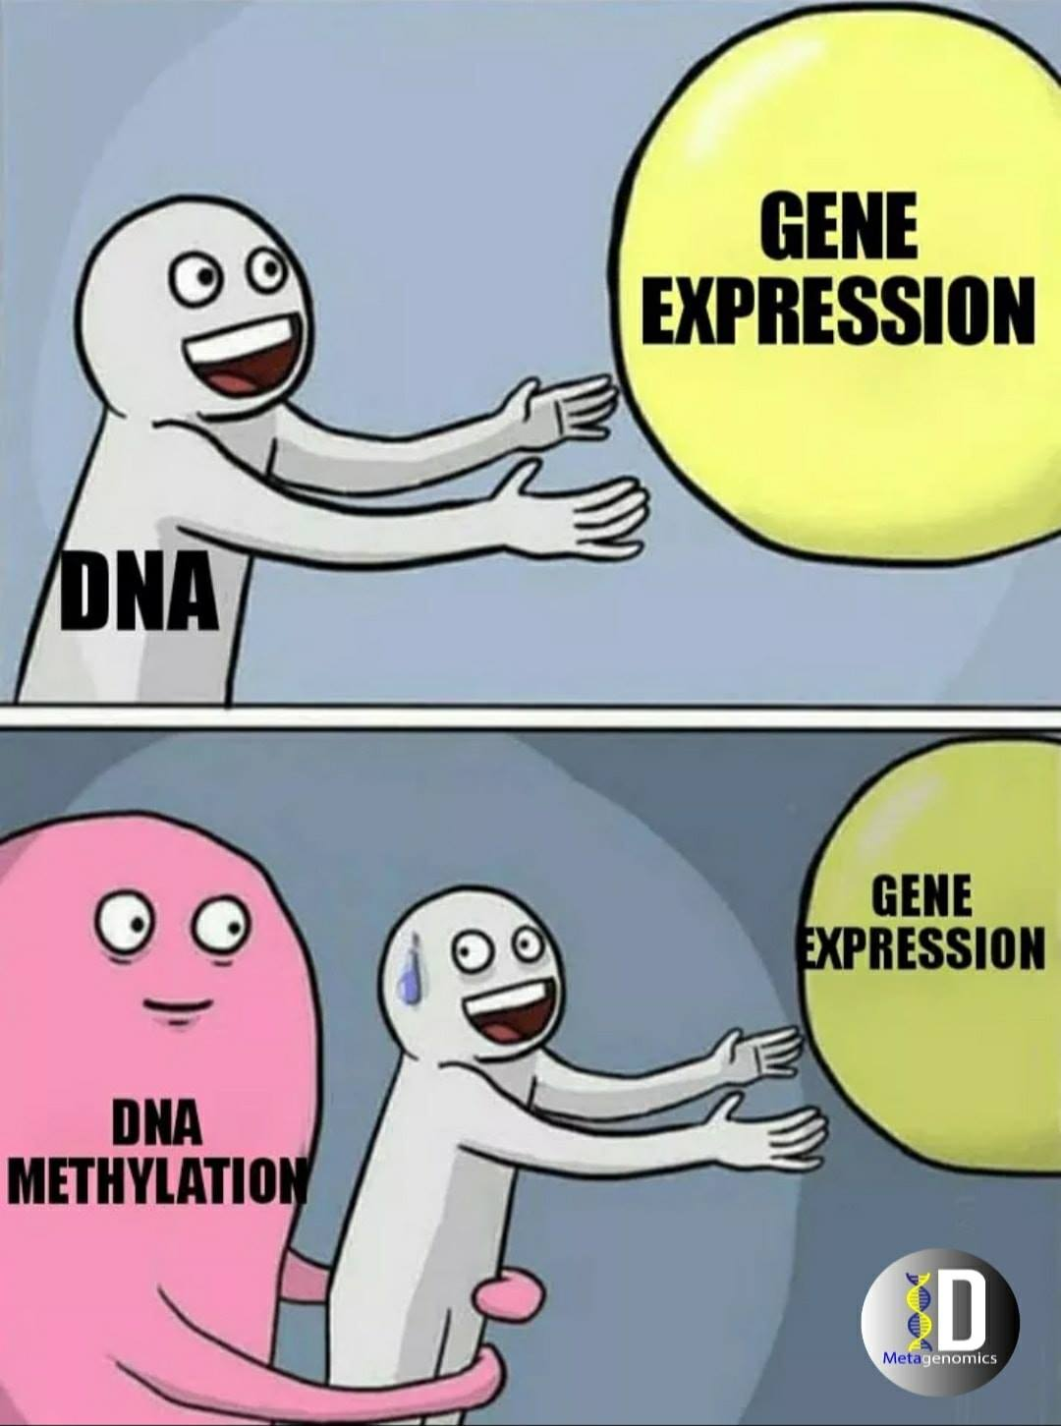
Munching the methylation data with
minfi
A high level Overview
By Group 1

Slide 2
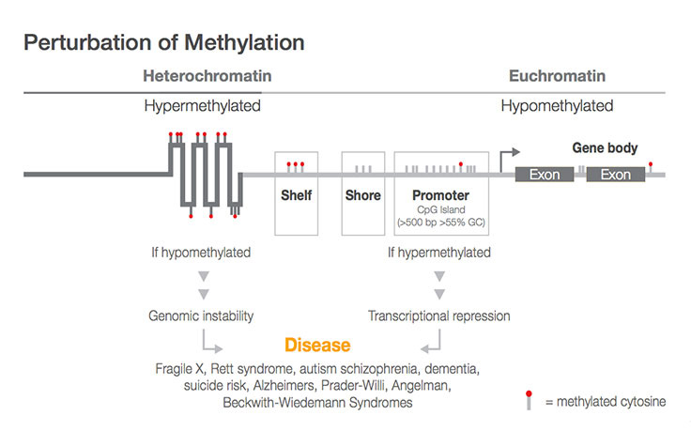
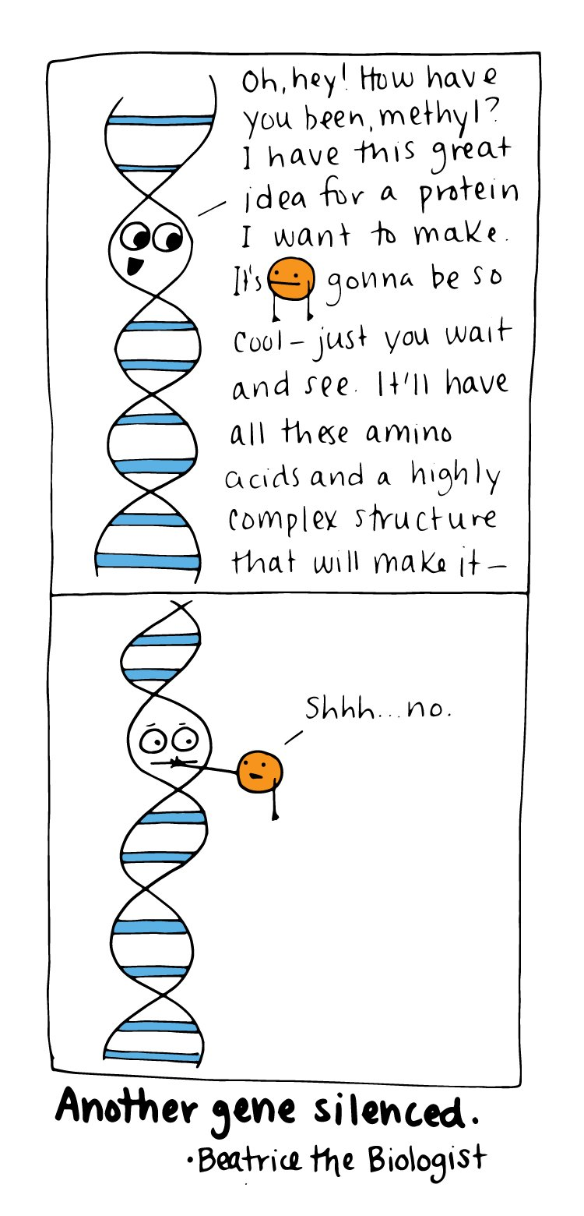
Why methylation?

Slide 3
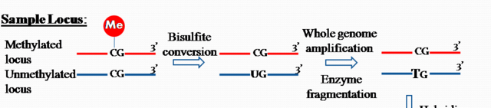
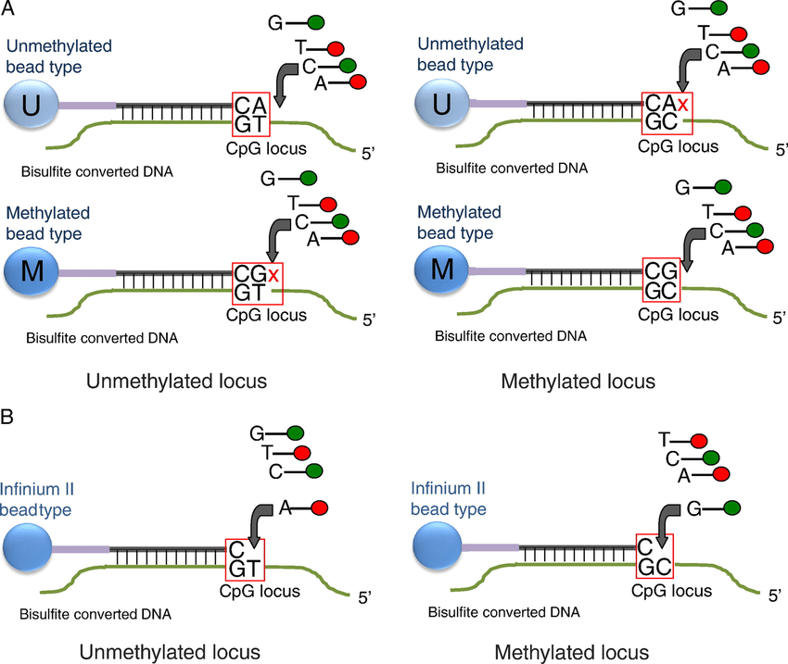
What is HumanMethylation450
1. Historical: Illumina on the HumanMethylation27 (27k) array:
measured methylation at approximately 27,000 CpGs, primarily in gene promoters.
Not truly considered “genome-wide”
2. Second Best: Illumina on the HumanMethylation450K (combined original Infinium I probes with the novel Infinium II probes.)
3. EPIC 850K: Additional ~350K CpGs in mainly enhancer regions.
Objective: Identify differences in DNA methylation between samples which can either be at a single CpG: aka differentially methylated position (DMP), or at a regional level which is called a differentially methylated region (DMR).
Source: Ross et al 2022; Batch-effect detection, correction and characterisation in Illumina HumanMethylation450 and MethylationEPIC BeadChip array data

Slide 4
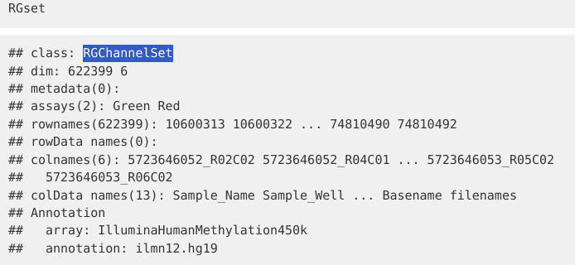
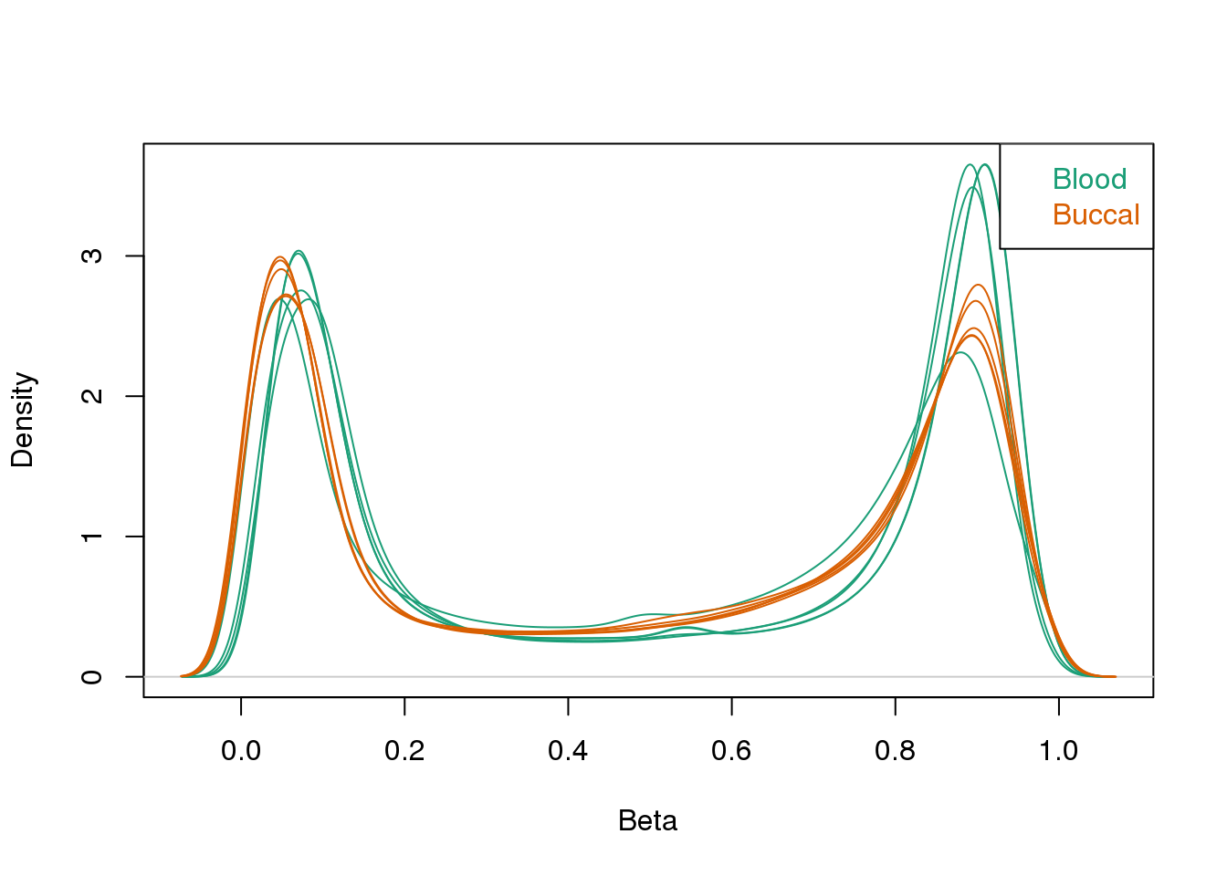
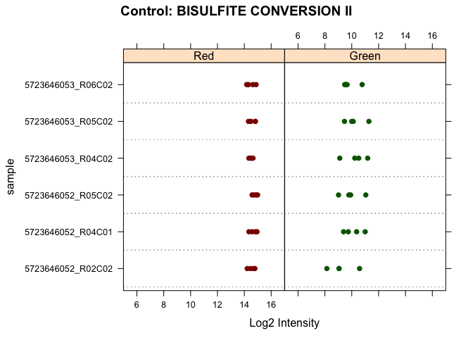
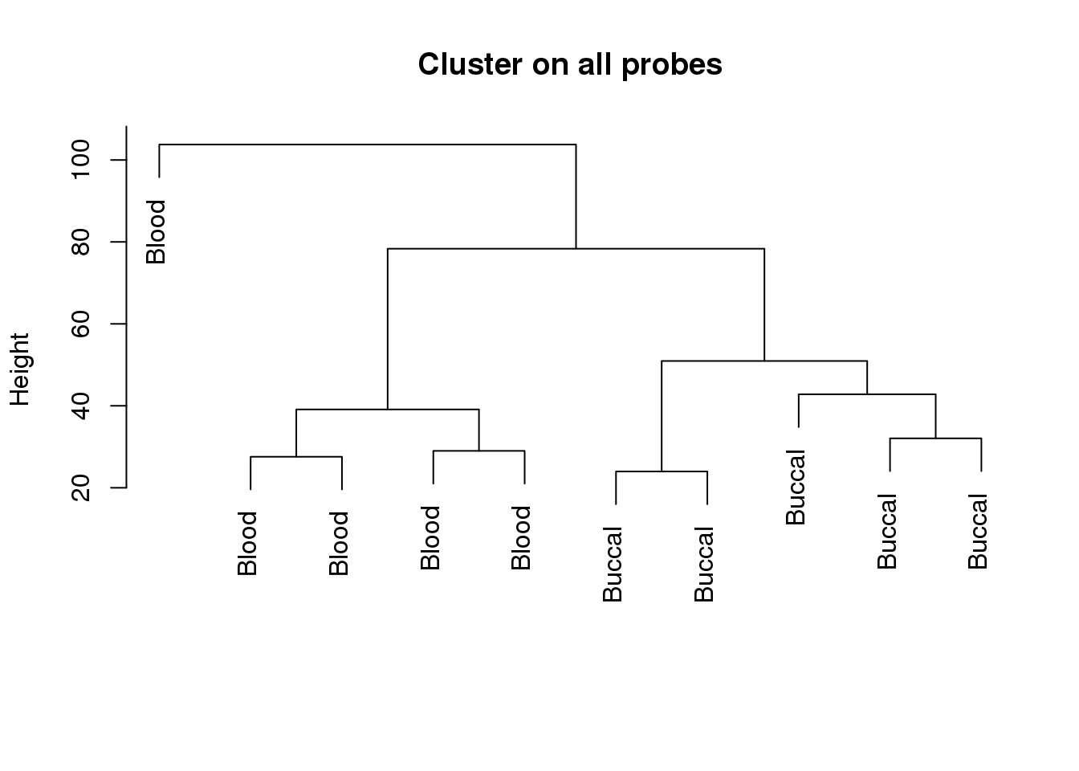
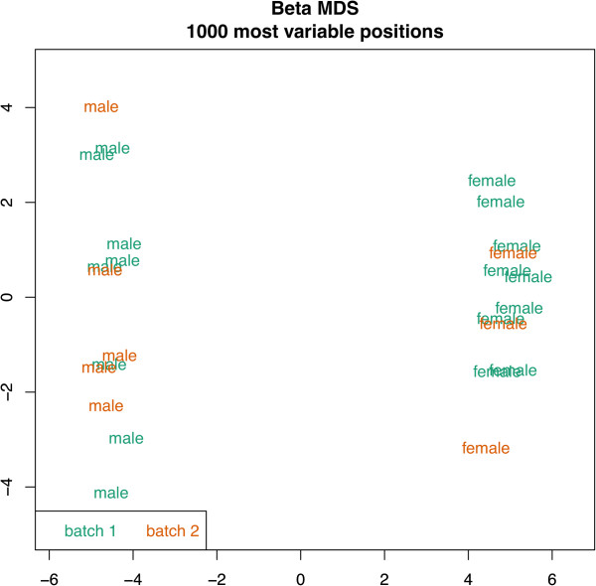
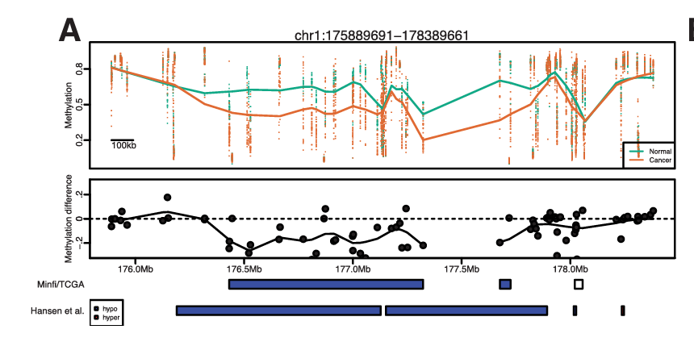
What Minfi offers
Functions to load and transform IDAT file (raw files obtained post microarray) using read.metharray.exp.
Perform basic QC.
Normalization (remember we are using probes from both infinium 1 and 2). Because these two types of probes use different methods (two colors vs. one color, and different biochemical reactions) to measure methylation, the data they produce are on slightly different scales. If left uncorrected - there would be a relative overenrichment of type I over type II probes in a top ranked list of probes correlating with a phenotype.
- Rule of thumb: If you expect global biological methylation differences in samples (eg: normal vs cancer) use preprocessFunnorm otherwise if having simple data (all from same tissue/cell type) use preprocessQuantile.
Data exploration usingMDS plot (similar to PCA).
Poor quality Probe filtering (since C to T conversions are the most common type of SNP in the human genome)
Probe-Wise Differential Methylation (Per base) using limma and dmpFinder.
Differentially methylated regions (DMRs for scale of gene promoters (1–2 kb)) using bumphunter.
Block finding (from 10Kbp-11Mbp)
Source: https://nbis-workshop-epigenomics.readthedocs.io/en/latest/content/tutorials/methylationArray/Array_Tutorial.html#data-exploration

Slide 5
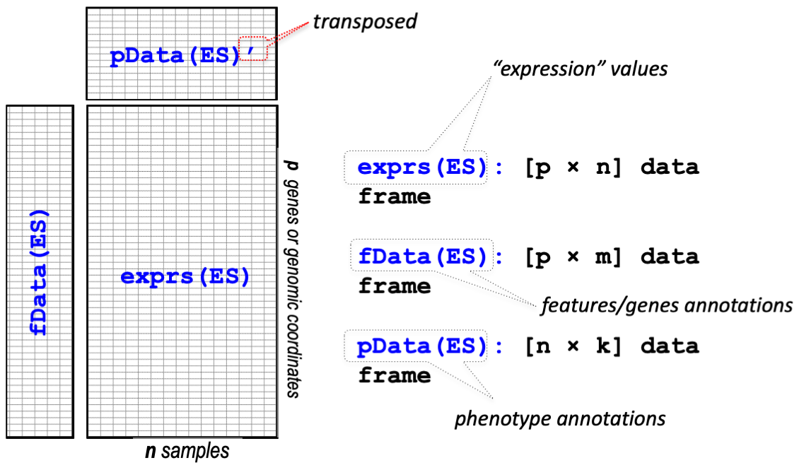
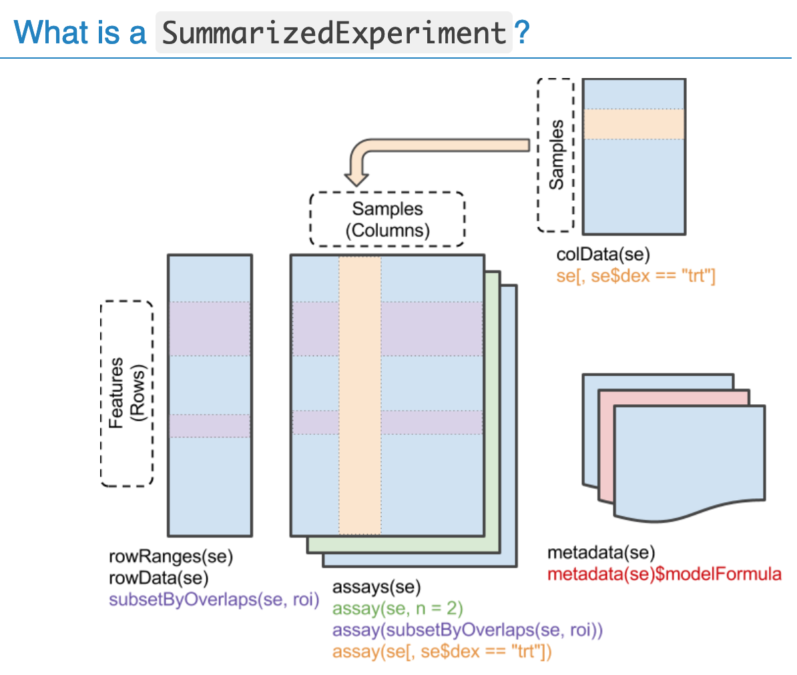
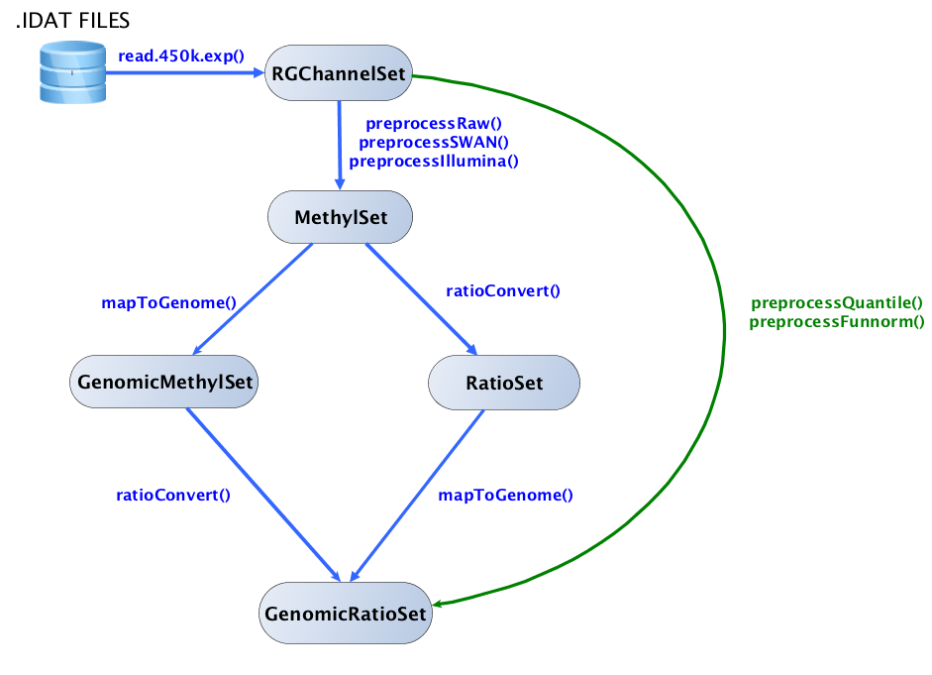
RGChannelSet
Don’t forget to check out shinyMethyl and EpiViz!!
Similar to ==
Source: https://bioconductor.org/help/course-materials/2015/BioC2015/methylation450k.html

